Slide 1

School of Computer Science
National University of Computer & Emerging Sciences – FAST
Course Code : NS 1001
Course Title : Applied Physics
Instructor: Engr. Muhammad Ahsan Khan
Summer Semester 2023

Slide 2
Contents
Waves & Type of Waves
Properties of Wave
(Frequency, Amplitude,Phase,Wavelength)
Mathematical Representation of a Wave

Slide 3

Visualize this image and tell what happens?

Slide 4

Visualize this image too and tell what happens?

Slide 5
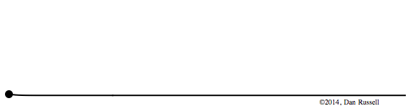
Notes:
Disturbance produces Motion
Motion produces Velocity in particles
Velocity creates Energy
During the energy travels the particles of medium made a pattern that pattern is called Wave

Slide 6
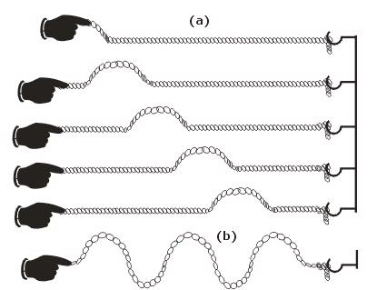
Q…What is a Wave?
Ans…Wave is… pattern of motion of particles of the medium which transport disturbance without transporting the medium.

Slide 7
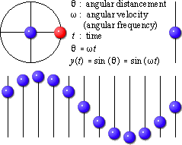
Motion of Particles in the Medium
It is a sinusoidal graph because particles oscillate according to the
“sine function”

Slide 8
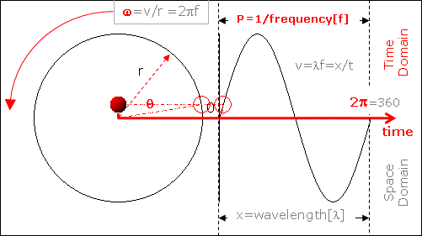
Formation of Sinusoidal Wave

Slide 9
Types of Waves
MECHANICAL WAVES
ELECTROMAGNETIC WAVES(EMW)
MATTER WAVES

Slide 10
Mechanical Waves
These waves are most familiar because we encounter
them almost constantly; common examples include water waves, sound waves.
All these waves have two central features:
They are governed by Newton’s laws,
and they can exist only within a material medium,
Examples: water, air, and rock.

Slide 11
ELECTROMAGNETIC WAVES
The disturbance of Electric and Magnetic Field is transported.
These waves require no material medium.
Examples include visible and ultraviolet light, radio and television waves, microwaves, x rays, and radar waves.
All electromagnetic waves travel through a vacuum at
speed c = 299 792 458 m/s.

Slide 12
Matter Waves
Although these waves are commonly used in modern technology, they are probably very unfamiliar to you.
These waves are associated with electrons, protons, and other fundamental particles, and even atoms and molecules. Because we commonly think of these particles as constituting matter, such waves are called matter waves.(study in modern physics)

Slide 13
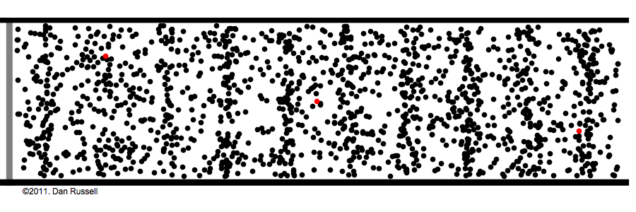
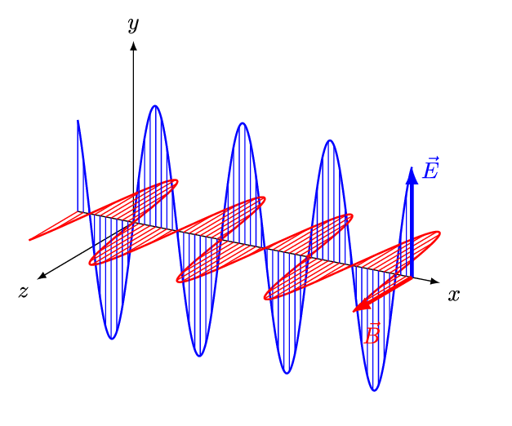
Classification of Waves
On the basis of Medium
Mechanical waves: require medium to travel
Electromagnetic waves:
do not require medium to travel.
Travel in free space

Slide 14
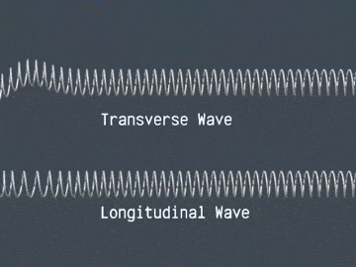
Classification of Waves
On the basis of vibration of particles
(in material/mechanical wave)
Transverse Waves
Longitudinal Waves

Slide 15
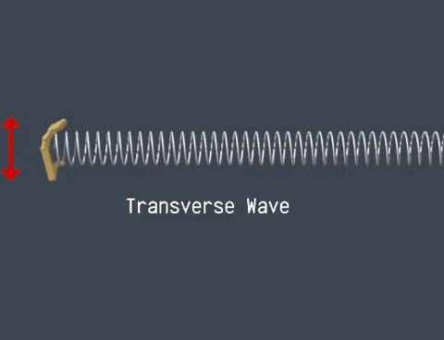
Transverse Waves
The waves in which particles of the medium vibrates perpendicular to the direction of propagation of wave are said to be transverse waves.
It travels in the form of crest
and trough.

Slide 16
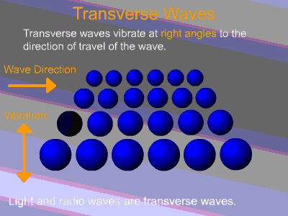
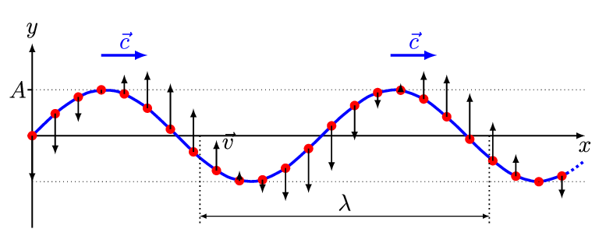


Slide 17
Transverse Waves(TW) …Cont’d
Limitation for the propagation of TW:
It transmits only in the medium having rigidity , means in solid and on the surface of liquids except gases.
There is no effect on Temperature and Pressure of the Medium while the transverse waves is being processed on it(medium).

Slide 18
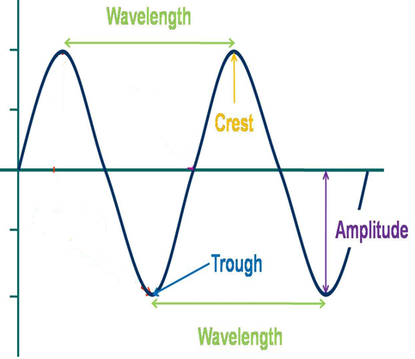
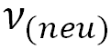
Parameters of TW
Amplitude (~A)
Frequency(~ )
Time Period(~ T)
Wavelength(~𝜆)
Crest & Trough

Slide 19
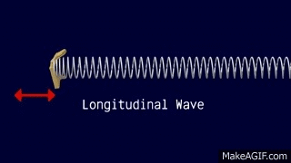
Longitudinal Waves
Waves in which particles of the medium vibrates in the same direction of propagation of the wave are said to be longitudinal waves.
It travels in the form of compression and rarefaction.

Slide 20
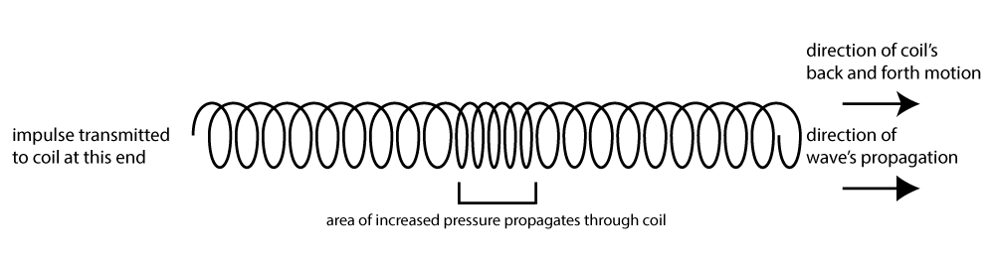
Longitudinal Waves (LW) …Cont’d

Slide 21
Longitudinal Waves (LW) …Cont’d
It travels in all types of medium i.e, solid, liquid and gases.
Temperature and Pressure of the Medium rises when the longitudinal waves is being processed on it.

Slide 22
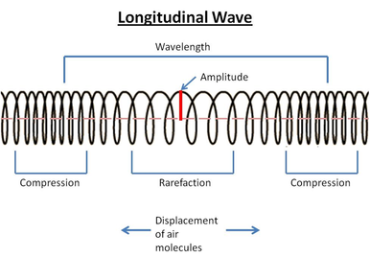
Parameters of LW
Amplitude (~A)
Frequency(~ )
Time Period(~ T)
Wavelength(~𝜆)
Compression & Rarefaction

Slide 23
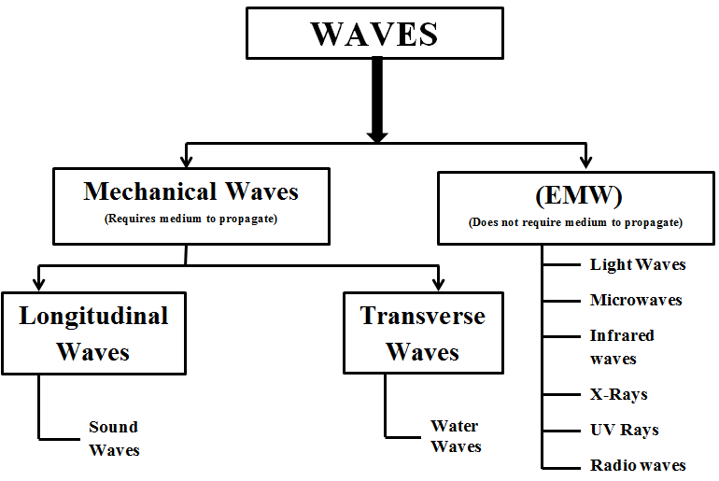

Slide 24
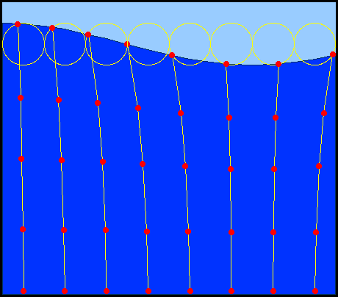
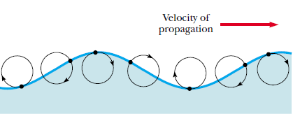
Combination of Transverse and Longitudinal Waves
Some waves in nature exhibit a combination of transverse and longitudinal displacements.
Surface water waves are a good example.
Note that in this disturbance has both transverse and longitudinal waves.

Slide 25
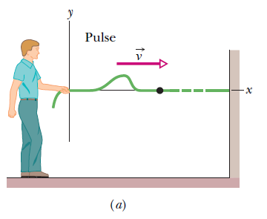
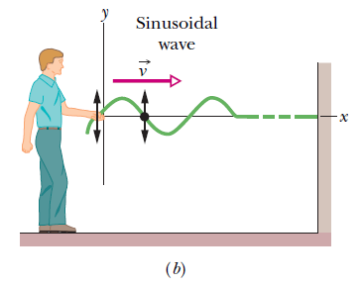
One Dimensional Pulse and a Wave Function
We need a function that gives the shape of the wave

Slide 26
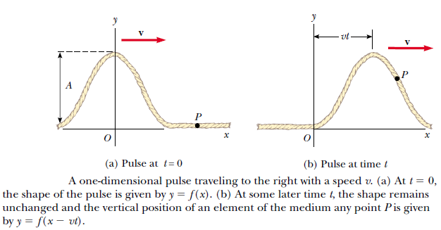
One Dimensional Pulse and a Wave Function

Slide 27
Wave Function
To completely describe a wave on a string (and the motion of any element along its length), we need a function that gives the shape of the wave.
y is the perpendicular displacement , x is the horizontal distance covered by wave in time t.

Slide 28
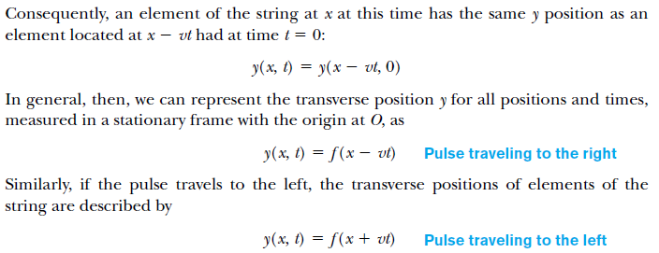
Wave Function

Slide 29
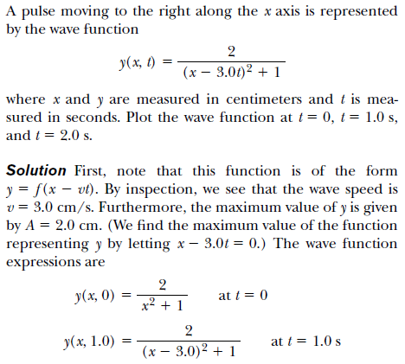
Example Problem 1
Pulse moving to the Right:

Slide 30
Example Problem 1
Pulse moving to the Right:

Slide 31
Example Problem 1
Pulse moving to the Right:

Slide 32
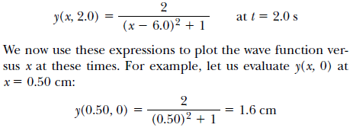
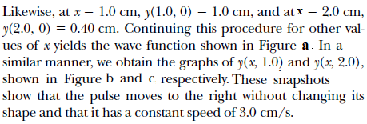
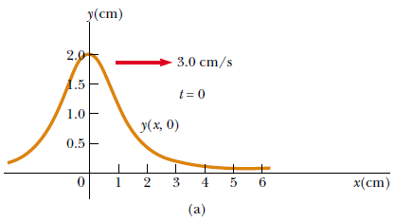
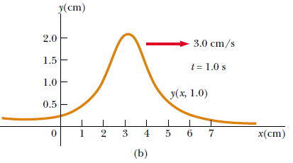
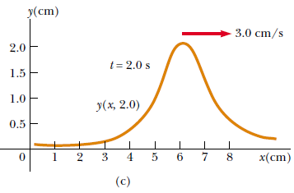

Slide 33
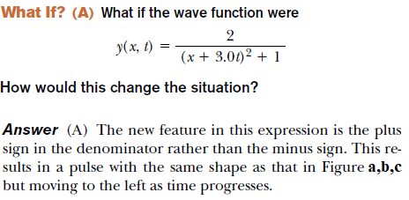
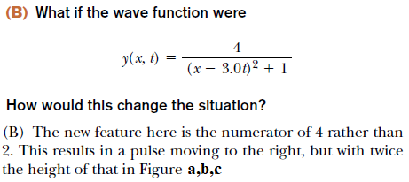

Slide 35
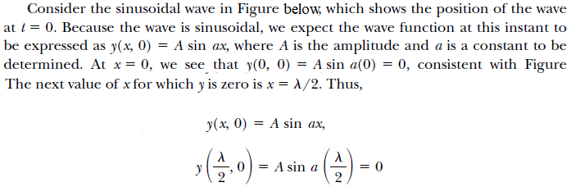
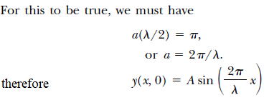
Sinusoidal Wave

Slide 36
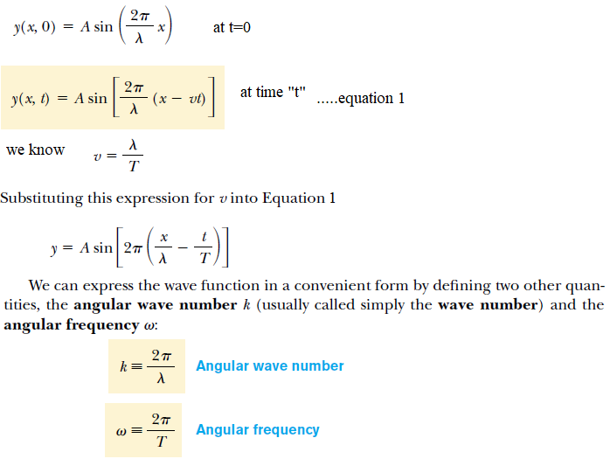

Slide 37
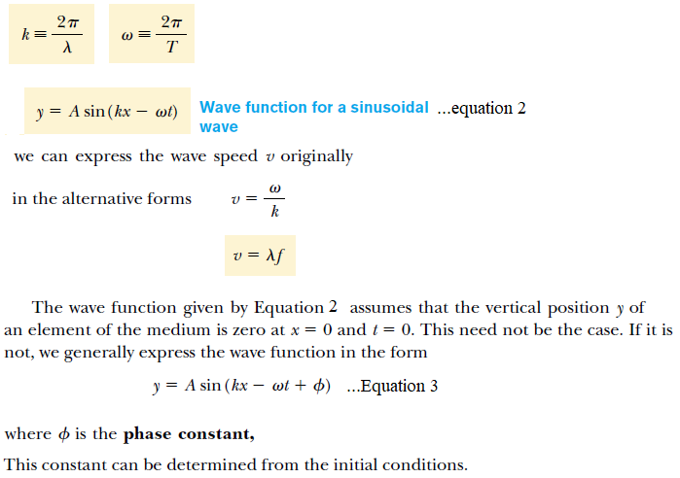


Slide 38
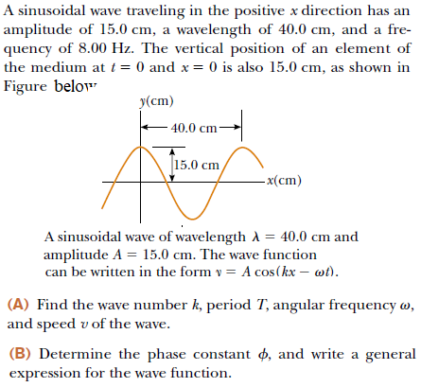
Example Problem 2

Slide 39
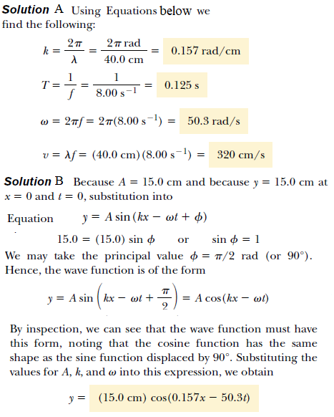
Example Problem 2

Slide 40
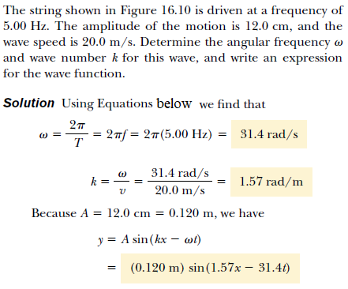
Example Problem 3

Slide 41
Example Problem 3

Slide 42
Practice Problems

Slide 43
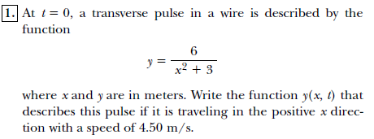
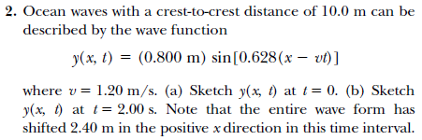
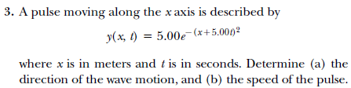
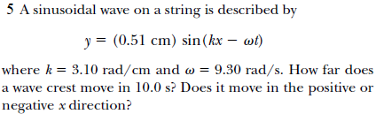
4. For a certain transverse wave, the distance between two successive crests is 1.20 m, and eight crests pass a given point along the direction of travel every 12.0 s. Calculate the wave speed

